Slide 1
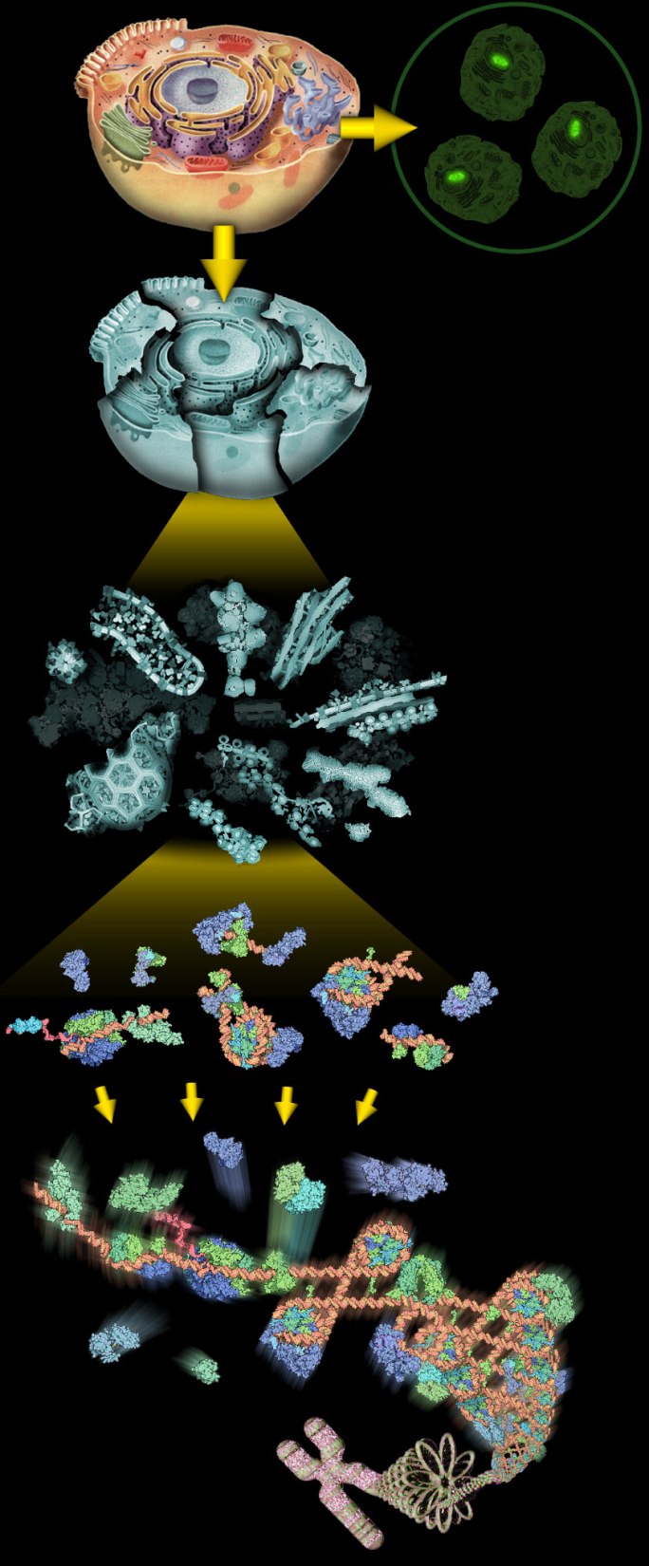
Proteomics Informatics Workshop
Part II: Protein Characterization
David Fenyö
February 18, 2011
Top-down/bottom-up proteomics
Post-translational modifications
Protein complexes
Cross-linking
The Global Proteome Machine Database

Slide 2
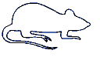
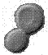
Proteomics Informatics
Biological System
Experimental
Design
Samples
Sample
Preparation
MS/MS
MS
Measurements
Data Analysis
What does the
sample contain?
How much?
What does the
sample contain?
How much?
Information about each sample
Information
Integration
Information about the biological system

Slide 3
Sample Preparation
Biological System
Experimental
Design
Samples
Enrichment
Separation etc
Sample
Preparation
MS/MS
Top
down
Digestion
MS
Measurements
Bottom
up
Proteins
Peptides
Data Analysis
What does the
sample contain?
How much?
What does the
sample contain?
How much?
Fragmentation
Information about each sample
Information
Integration
Fragments
Information about the biological system

Slide 4
Top down / bottom up
Top down
Bottom up
intensity
mass/charge

Slide 5
Top down Bottom up
Charge distribution
2+
27+
31+
intensity
intensity
3+
4+
1+
mass/charge
mass/charge

Slide 6
Top down Bottom up
Isotope distribution
intensity
intensity
mass/charge
mass/charge

Slide 7
Fragmentation
Top down
Bottom up
Fragmentation

Slide 8
Correlations between modifications
Top down
Bottom up

Slide 9
Alternative Splicing
Top down
Exon 1
2
3
Bottom up

Slide 10
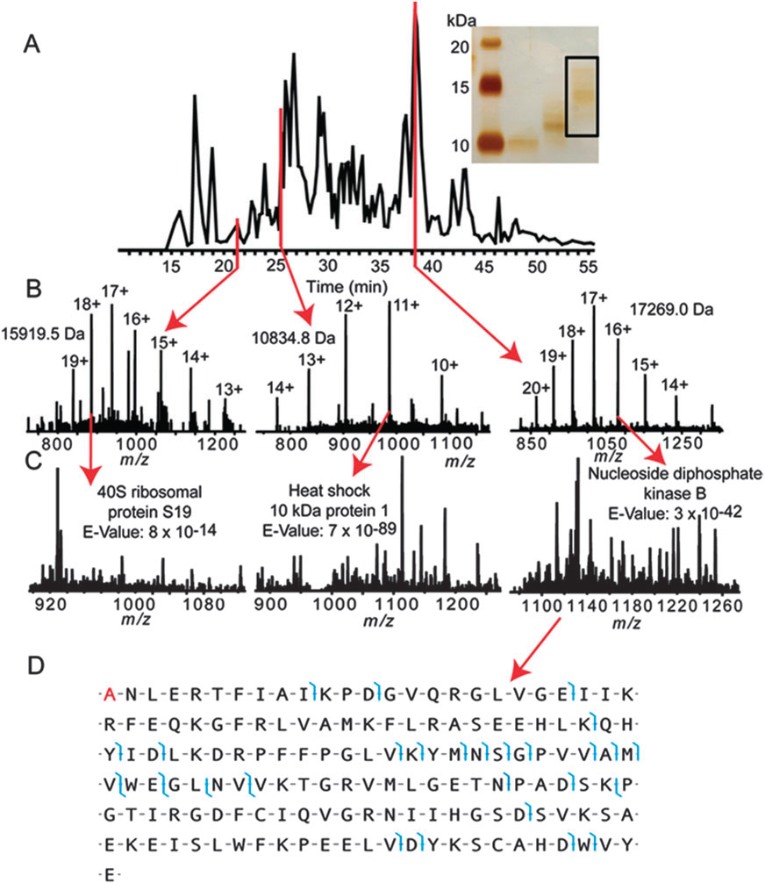
Top down
Protein
mass spectra
Fragment
mass spectra
Kellie et al., Molecular BioSystems 2010

Slide 11
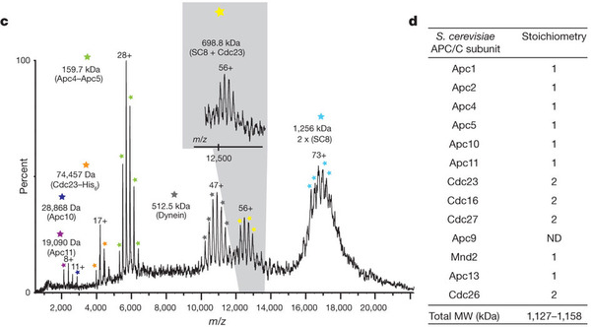
Non-Covalent Protein Complexes
Schreiber et al., Nature 2011

Slide 12
Dynamic Range in Proteomics
Distribution of
Protein Amounts
Number of Proteins
Experimental
Dynamic Range
Log (Protein Amount)
Desired Dynamic Range
Large discrepancy between the experimental dynamic
range and the range of amounts of different proteins in a proteome
The goal is to identify and characterize all components of a proteome

Slide 13
Experimental Designs Simulated

Slide 14
Parameters in Simulation
● Distribution of protein amounts in sample
● # of Proteins in each fraction
● Total amount of peptides that are loaded on column (limited by column loading capacity)
● Total amount of peptides that are loaded on column (limited by column loading capacity)
● Loss of peptides before binding to the column
● # of peptide fractions
● # of peptide fractions
● Loss of peptides after elution off the column
● Distribution of mass spectrometric response for different peptides present at the same amount
● Dynamic range of mass spectrometer
● Detection limit of mass spectrometer

Slide 15
Simulation Results for 1D-LC-MS
Tissue
No Protein
Separation
Body Fluid
No Protein
Separation
Complex Mixtures
of Proteins
Digestion
RPC
Tissue
Protein
Separation:
10 fractions
Body Fluid
Protein
Separation:
10 fractions
MS Analysis

Slide 16
Success Rate of a Proteomics Experiment
Distribution of
Protein Amounts
Number of Proteins
Proteins
Detected
Log (Protein Amount)
DEFINITION: The success rate of a proteomics experiment is defined as the number of proteins detected divided by the total number of proteins in the proteome.

Slide 17
Relative Dynamic Range of a Proteomics Experiment
Distribution of
Protein Amounts
Number of Proteins
Proteins
Detected
RDR₉₀
RDR₅₀
Fraction of
Proteins Detected
RDR₁₀
Log (Protein Amount)
DEFINITION: RELATIVE DYNAMIC RANGE, RDR_{x},
where x is e.g. 10%, 50%, or 90%

Slide 18
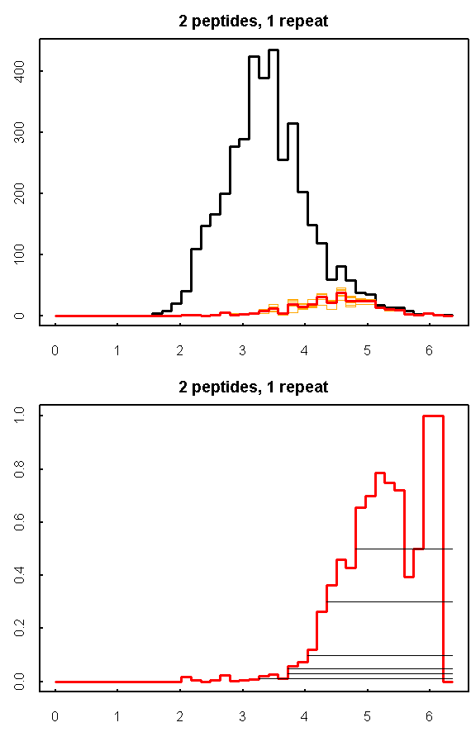
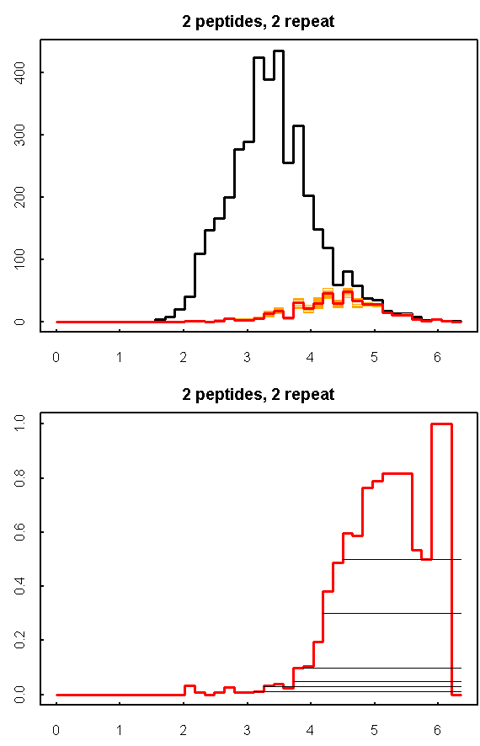
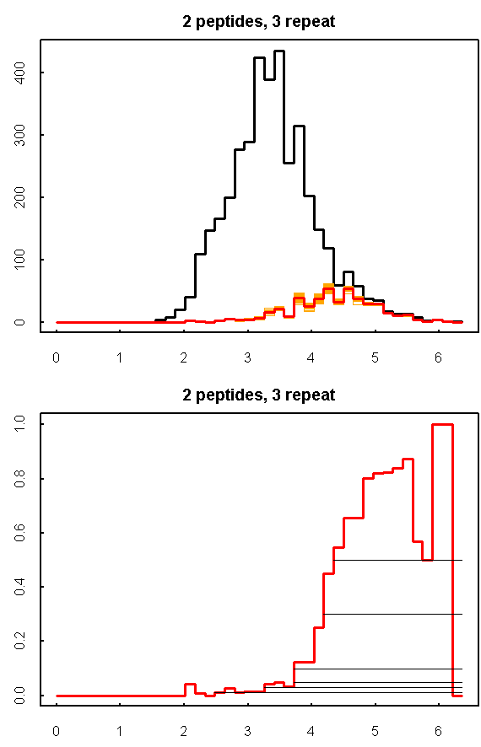
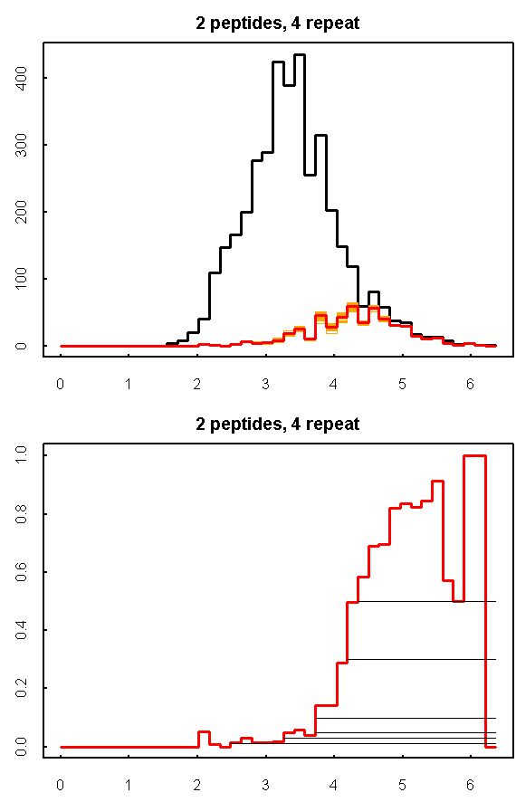

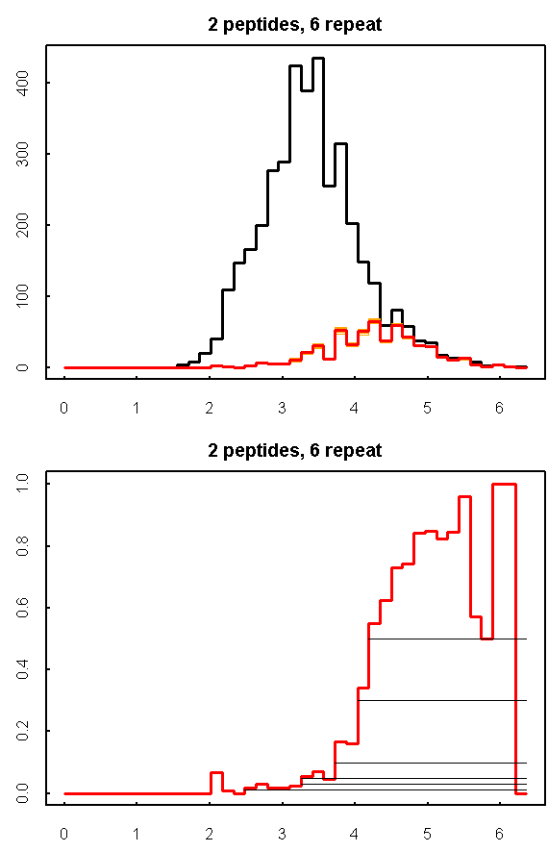
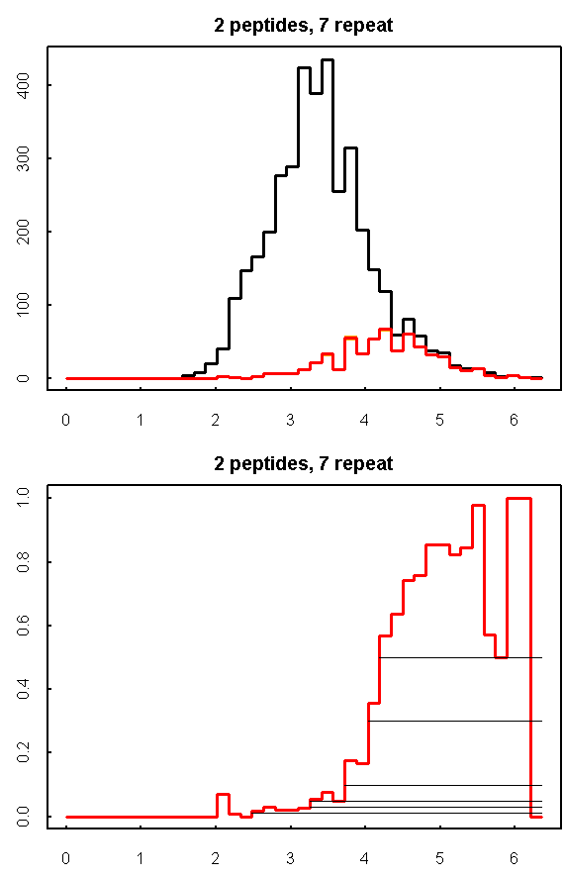
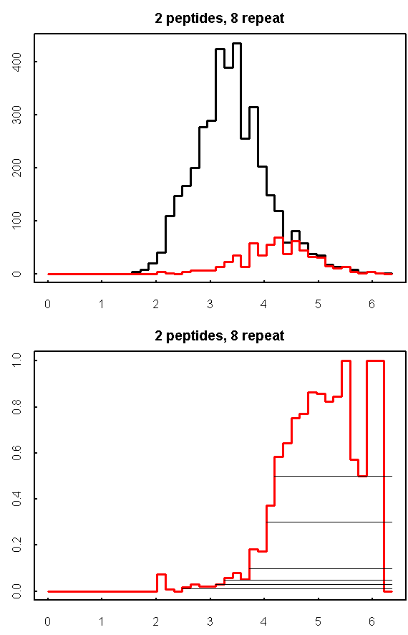
Repeat Analysis
2 Analyses
3 Analyses
4 Analyses
5 Analyses
6 Analyses
7 Analyses
8 Analyses
1 Analysis

Slide 19
Repeat Analysis:
Comparison of Simulations and Experiments

Slide 20
Number of Proteins in Mixture
RDR₅₀
Success Rate
2
1
2
1
Tissue
Body Fluid
Tissue
1
Tissue
2
Body Fluid
1
Body Fluid
2

Slide 21
Amount loaded and peptide separation
Tissue
Peptide
separation
Tissue
Tissue
Tissue
Order:
Amount
loaded
1. Protein separation
2. Amount loaded
3. Peptide separation
Amount
loaded
Protein
separation
Protein
separation
Protein
separation
Tissue
Tissue
Tissue
Amount
loaded
1. Protein separation
2. Peptide separation
3. Amount loaded
Peptide
separation
Peptide
separation
Protein
separation
Protein
separation
Protein
separation
Ranges:
Protein separation: 30000 – 3000 proteins in each fraction
Amount loaded: 0.1 ug – 10 ug
Peptide separation: 100 – 1000 fractions
Protein separation
Amount loaded
Peptide separation

Slide 22
Localization of modifications
Phosphopeptide identification
m_{precursor} = 2000 Da
Δm_{precursor} = 1 Da
Δm_{fragment} = 0.5 Da
Phosphorylation

Slide 23
Localization of modifications
d_{min}>=3 for 47% of human tryptic peptides
Localization (d_{min}=3)
m_{precursor} = 2000 Da
Δm_{precursor} = 1 Da
Δm_{fragment} = 0.5 Da
Phosphorylation
Notes:
23

Slide 24
Localization of modifications
d_{min}=2 for 33% of human tryptic peptides
Localization (d_{min}=2)
m_{precursor} = 2000 Da
Δm_{precursor} = 1 Da
Δm_{fragment} = 0.5 Da
Phosphorylation
Notes:
24

Slide 25
Localization of modifications
d_{min}=1 for 20% of human tryptic peptides
Localization (d_{min}=1)
m_{precursor} = 2000 Da
Δm_{precursor} = 1 Da
Δm_{fragment} = 0.5 Da
Phosphorylation
Notes:
25

Slide 26
Localization of modifications
Localization
(d=1*)
m_{precursor} = 2000 Da
Δm_{precursor} = 1 Da
Δm_{fragment} = 0.5 Da
Phosphorylation
Notes:
26

Slide 27
Localization of modifications
Peptide with two possible modification sites

Slide 28
Localization of modifications
Peptide with two possible modification sites
MS/MS spectrum
Intensity
m/z

Slide 29
Localization of modifications
Peptide with two possible modification sites
Matching
MS/MS spectrum
Intensity
m/z

Slide 30
Localization of modifications
Peptide with two possible modification sites
Matching
MS/MS spectrum
Intensity
m/z
Which assignment does
the data support?
1, 1 or 2, or 1 and 2?

Slide 31
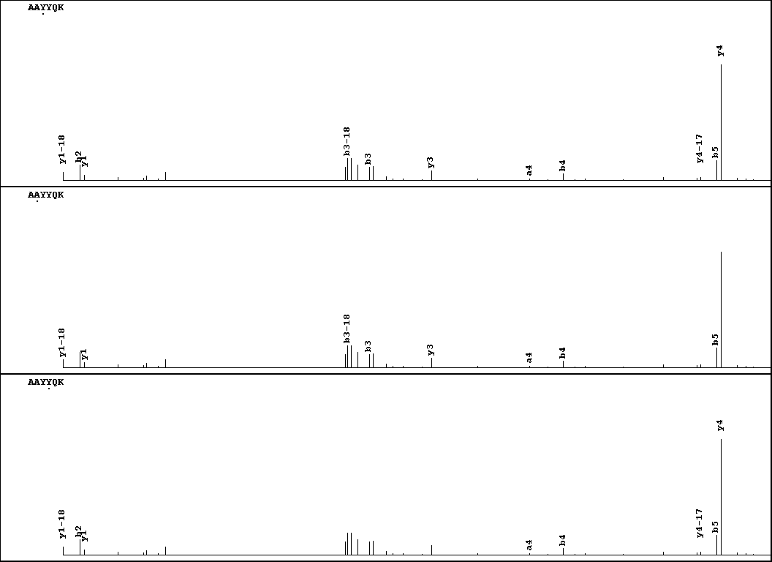
Visualization of evidence for localization
AAYYQK
AAYYQK

Slide 32
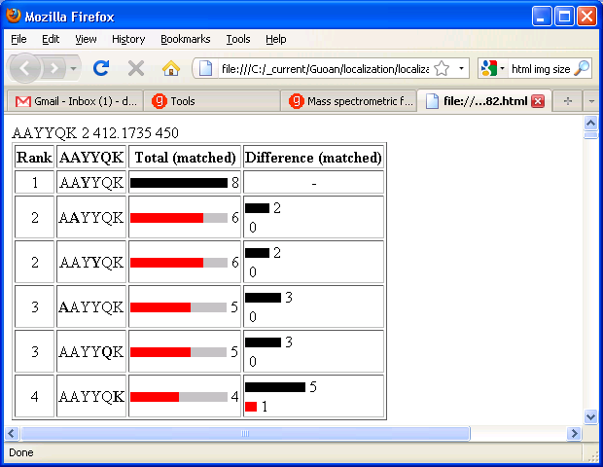
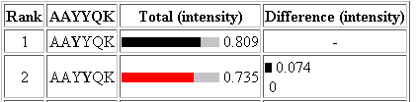
Visualization of evidence for localization

Slide 33
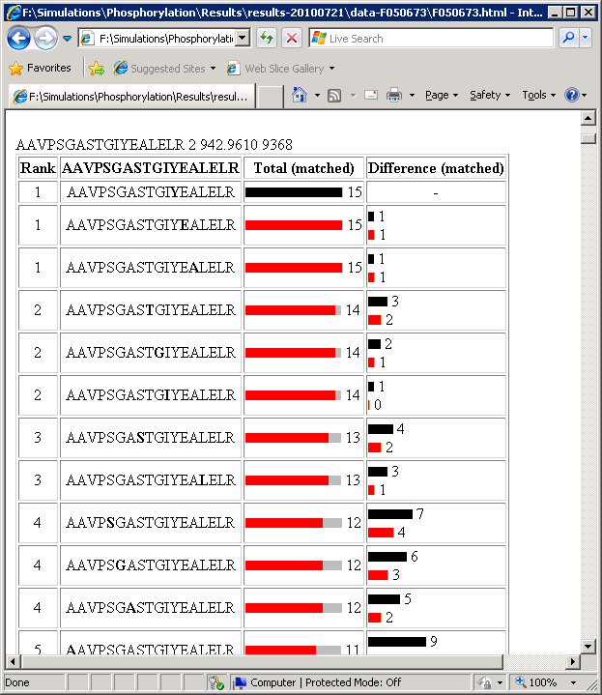
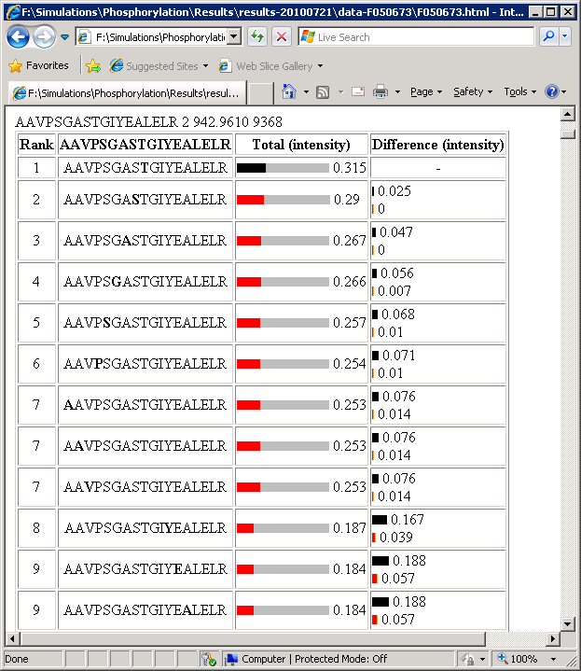
Visualization of evidence for localization
1
2
3
1
2
3

Slide 34
Estimation of global false
localization rate using decoy sites
By counting how many times the phosphorylation is localized to amino acids that can not be phosphorylated we can estimate the false localization rate as a function of amino acid frequency.
False localization frequency
Y
Amino acid frequency

Slide 35
How much can we trust a
single localization assignment?
If we can generate the distribution of scores for assignment 1 when 2 is the correct assignment, it is possible to estimate the probability of obtaining a certain score by chance for a given peptide sequence and MS/MS spectrum assignment.

Slide 36
Is it a mixture or not?
If we can generate the distribution of scores for assignment 2 when 1 is the correct assignment, it is possible to estimate the probability of obtaining a certain score by chance for a given peptide sequence and MS/MS spectrum assignment.

Slide 37
Localization of modifications
1 and 2
1
Ø
1 or 2

Slide 38
Protein Complexes
A
D
A
C
B
Digestion
Mass spectrometry

Slide 39
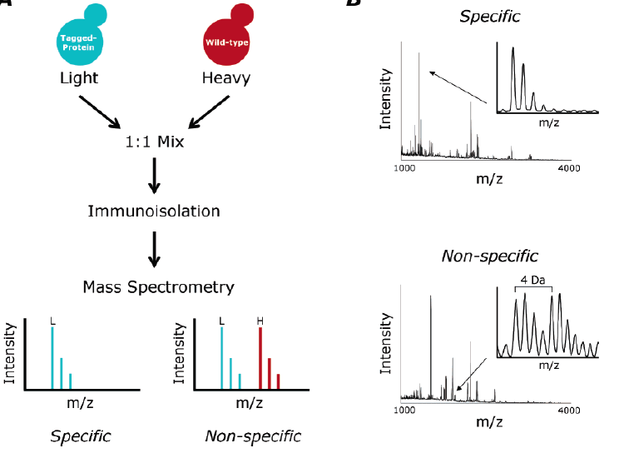
Protein Complexes – specific/non-specific binding
Tackett et al. JPR 2005

Slide 40
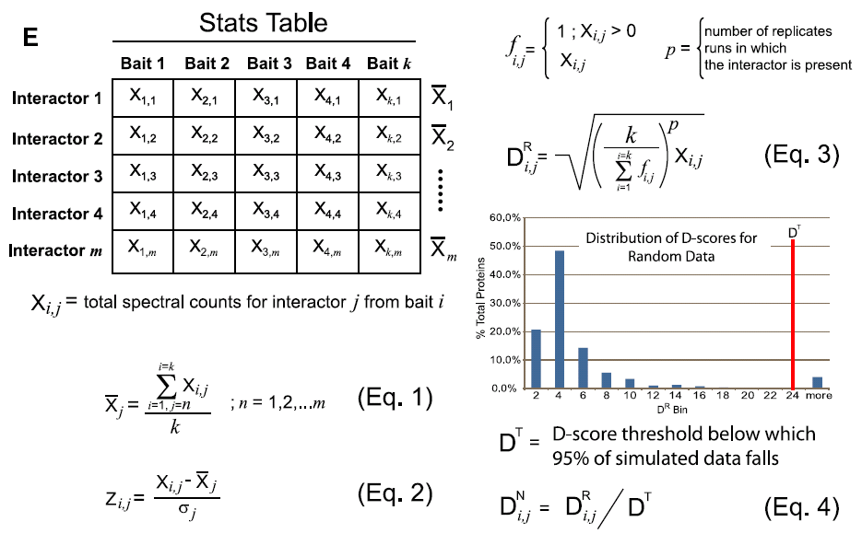
Protein Complexes – specific/non-specific binding
Sowa et al., Cell 2009

Slide 41
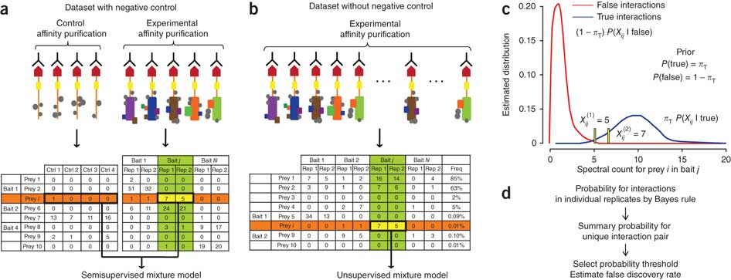
Protein Complexes – specific/non-specific binding
Choi et al., Nature Methods 2010

Slide 42
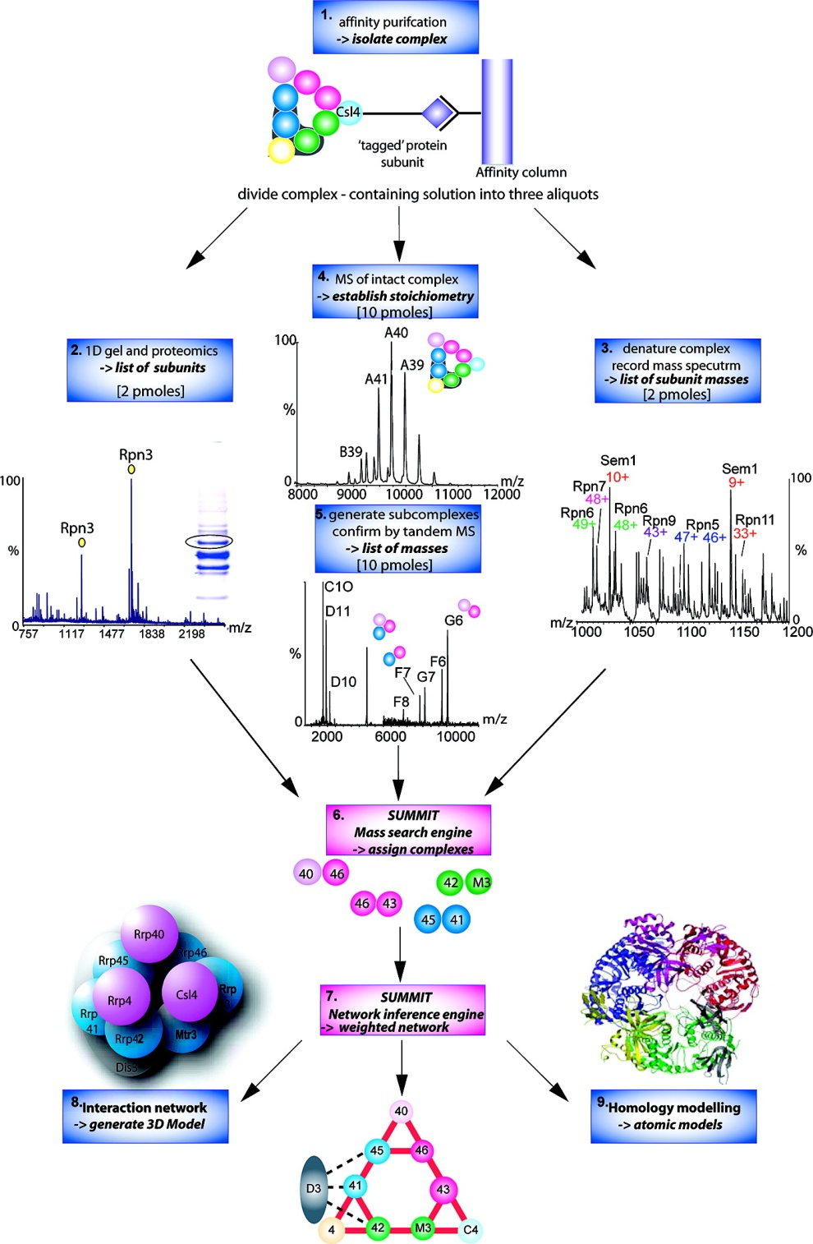
Analysis of Non-Covalent Protein Complexes
Taverner et al., Acc Chem Res 2008

Slide 43
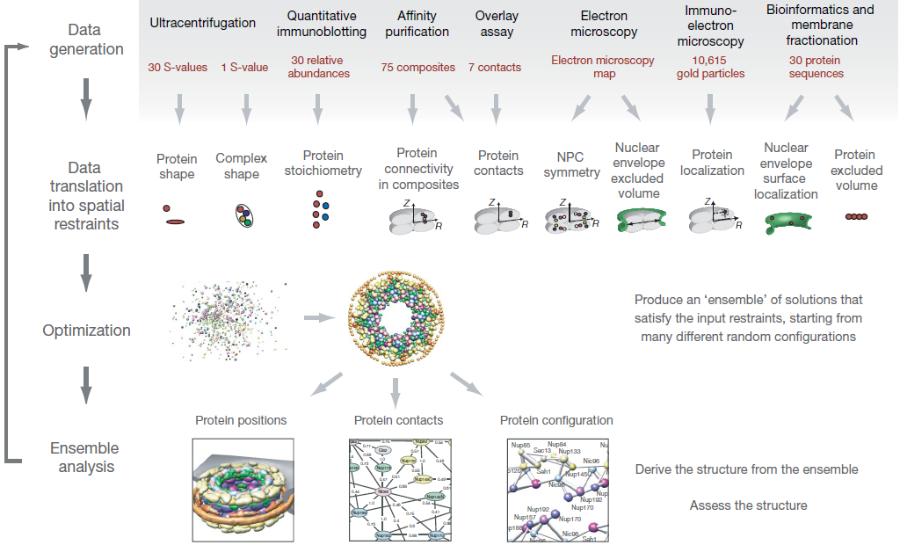
Determining the architectures of macromolecular assemblies
Alber et al., Nature 2007

Slide 44
Protein
Complex
Interaction Partners by Chemical Cross-Linking
Chemical Cross-Linking
Cross-Linked
Protein Complex
Enzymatic Digestion
MS
Proteolytic
Peptides
Isolation
Fragmentation
MS/MS
Peptides
Fragments
M/Z

Slide 45
Protein
Complex
Interaction Sites by Chemical Cross-Linking
Chemical Cross-Linking
Cross-Linked
Protein Complex
Enzymatic Digestion
MS
Proteolytic
Peptides
Isolation
Fragmentation
MS/MS
Peptides
Fragments
M/Z

Slide 46
Cross-linking
protein
n peptides with reactive groups
(n-1)n/2 potential ways to cross-link peptides pairwise
+ many additional uninformative forms
Protein A + IgG heavy chain 990 possible peptide pairs
Yeast NPC ˜10⁶ possible peptide pairs

Slide 47
Cross-linking
Mass spectrometers have a limited dynamic range and it therefore important to limit the number of possible reactions not to dilute the cross-linked peptides.
For identification of a cross-linked peptide pair, both peptides have to be sufficiently long and required to give informative fragmentation.
High mass accuracy MS/MS is recommended because the spectrum will be a mixture of fragment ions from two peptides.
Because the cross-linked peptides are often large, CAD is not ideal, but instead ETD is recommended.

Slide 48
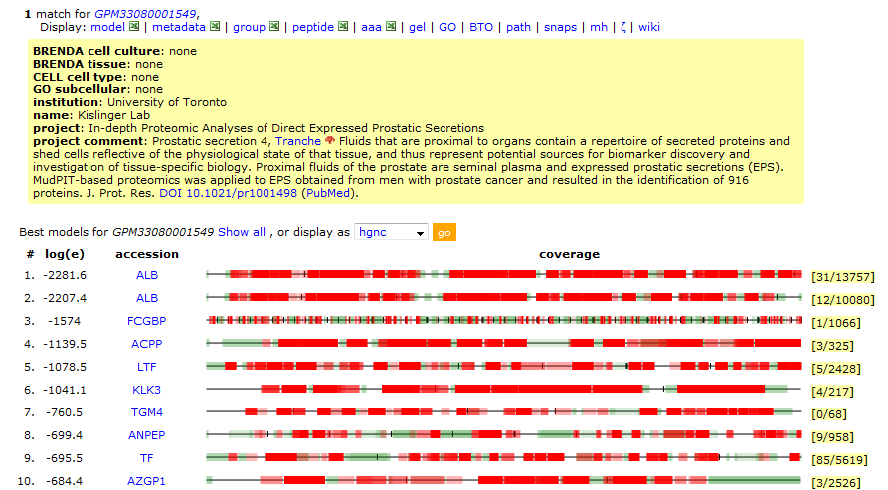
Search Results

Slide 49
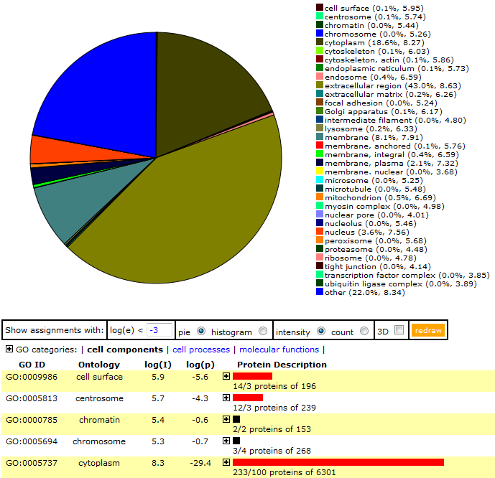
Search Results

Slide 50
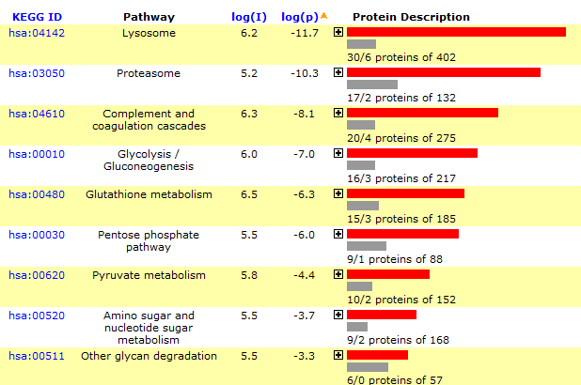
Search Results

Slide 51
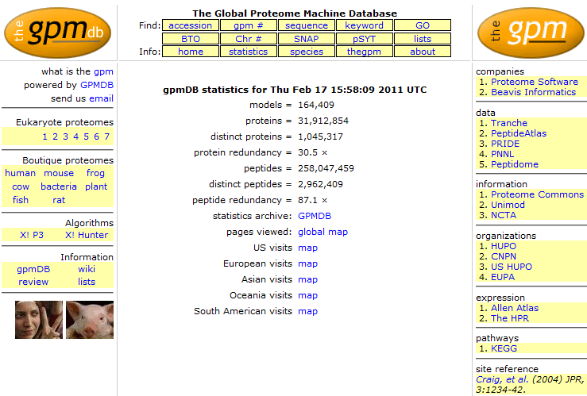
GPMDB

Slide 52
Sequence-spectrum assignments in GPMDB
Assigned spectra
Year (as of Jan 1st)

Slide 53
Human Genes Observed in GPMDB

Slide 54
Proteotypic peptide relative composition
✓ ✓

Slide 55
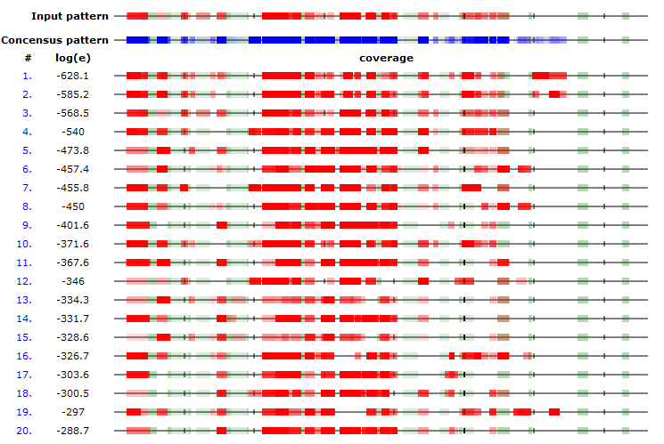
Comparison with GPMDB
Most proteins show very reproducible peptide patterns

Slide 56
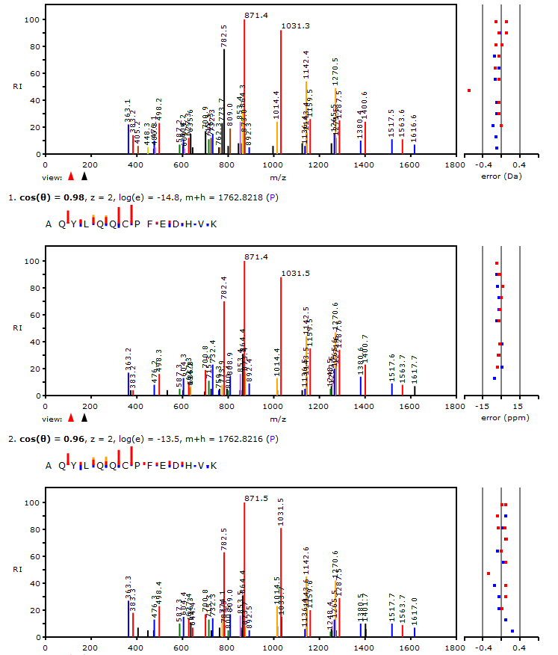
Comparison with GPMDB

Slide 57
Global frequency of observing a peptide
Peptide Sequence | Observations
FSTVAGESGSADTVR | 2633
FNTANDDNVTQVR | 2432
AFYVNVLNEEQR | 1722
LVNANGEAVYCK | 1701
GPLLVQDVVFTDEMAHFDR | 1637
LSQEDPDYGIR | 1560
LFAYPDTHR | 1499
NLSVEDAAR | 1400
FYTEDGNWDLVGNNTPIFFIR | 1386
ADVLTTGAGNPVGDK | 1338

Slide 58
Global frequency of observing a peptide
If the number of times a peptide sequence (i) has been observed is n_{i}, then for a particular protein:

Slide 59
Global frequency of observing a peptide (ω)
Define a normalized global frequency of observation for a particular peptide sequence from a particular protein as:

Slide 60
Global frequency of observation (ω), catalase
Peptide Sequence | ω
FSTVAGESGSADTVR | 0.08
FNTANDDNVTQVR | 0.07
AFYVNVLNEEQR | 0.05
LVNANGEAVYCK | 0.05
GPLLVQDVVFTDEMAHFDR | 0.05
LSQEDPDYGIR | 0.04
LFAYPDTHR | 0.04
NLSVEDAAR | 0.04
FYTEDGNWDLVGNNTPIFFIR | 0.04
ADVLTTGAGNPVGDK | 0.04

Slide 61
Global frequency of observation (ω), catalase
ω
Peptide sequences

Slide 62
Omega (Ω) value for a protein identification
For any set peptides observed in an experiment assigned to a particular protein (1 to j ):

Slide 63
Protein Ω’s for a set of identifications
Protein ID | Ω (z=2) | Ω (z=3)
SERPINB1 | 0.88 | 0.82
SNRPD1 | 0.88 | 0.59
CFL1 | 0.81 | 0.87
SNRPE | 0.8 | 0.81
PPIA | 0.79 | 0.64
CSTA | 0.79 | 0.36
PFN1 | 0.76 | 0.61
CAT | 0.71 | 0.78
GLRX | 0.66 | 0.8
CALM1 | 0.62 | 0.76
FABP5 | 0.57 | 0.17

Slide 64
Proteomics Consultation
Part of Best Practices Integrative Informatics Consultation Service (BPIC) at the NYU Center for Health Informatics and Bioinformatics (CHIBI)
Contact
InformaticsConsultation@nyumc.org
or
David.Fenyo@nyumc.org
Walk-in Clinic:
Wednesday, February 23, 3-5 pm
227 E 30th Street, 7th Floor, Room #739

Slide 65
Proteomics Informatics Workshop
Part III: Protein Quantitation
February 25, 2011
Metabolic labeling – SILAC
Chemical labeling
Label-free quantitation
Spectrum counting
Stoichiometry
Protein processing and degradation
Biomarker discovery and verification

Slide 66
Proteomics Informatics Workshop
Part I: Protein Identification, February 4, 2011
Part II: Protein Characterization, February 18, 2011
Part III: Protein Quantitation, February 25, 2011

